Slide 1

Writing simpler ASP.NET Core
It’s the future!!
Come join the Not So SOLID Crew!
Notes:
So I’m going to guess that everyone is at Troy Hunt’s talk as there’s not many people here. Well I thought this might happen so as he was hacking someone’s wifi last night and doing things with a pineapple that’ll make your eyes water I crept into his room and found his lucky charm! He’s now next door in complete panic mode about to produce the worst talk of his career!
Has everyone had a good week at NDC? Who’s learnt a lot? Who’s tired? Who can cope with one more talk? Hopefully the organizers have left the best to last! If the person you are sitting next to let us all know so we can get the marker pens out!

Slide 2
Who am I?
I asked Twitter to write my profile!
@mrsacs
@danbarua
J Channon - he's alright but he smells a bit. Couch for sale.
Possesses all five fingers on each hand, leading one to suspect he's not really from round 'ere. "He's not so bad when you get to know him.
@joe_stead
@chrissie1
MVP, Architect, Twitter Complainer, GitHub enthusiast.
Said no-one ever
@ntcoding
@luisrudge
Johnny Chanson. A World Class village idiot with deep expertise in circumventing the best features of type safe programming languages. In addition he is literally a canon
Knows his shit
@morcs
@jchannon
Oursourcer of bios
Got into OSS, got child named after him, isn't that right @khellang ?!
@henriksen
@mholo65
Whenever someone screwed up, he knew how to fix it. Can you imagine how many times he's screwed up to learn that!?
Puts usings inside namespace declarations and names libraries after Backstreet Boys...
Notes:
Who ready my profile before coming to this session?
And you still came?

Slide 3

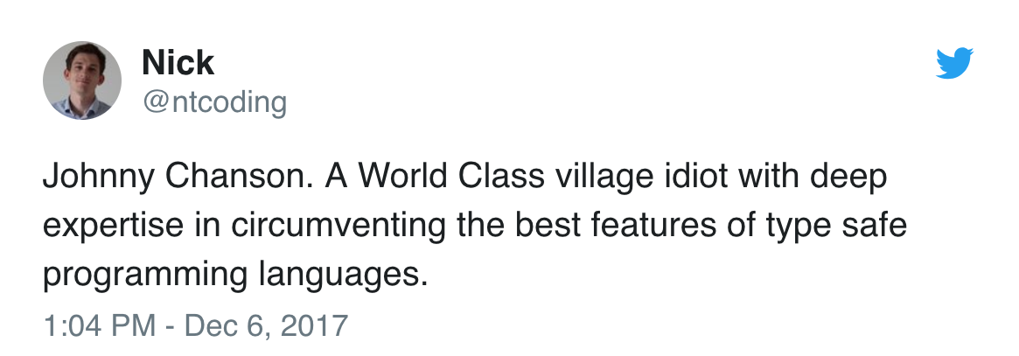
Who am I?
I asked Twitter to write my profile

Slide 4
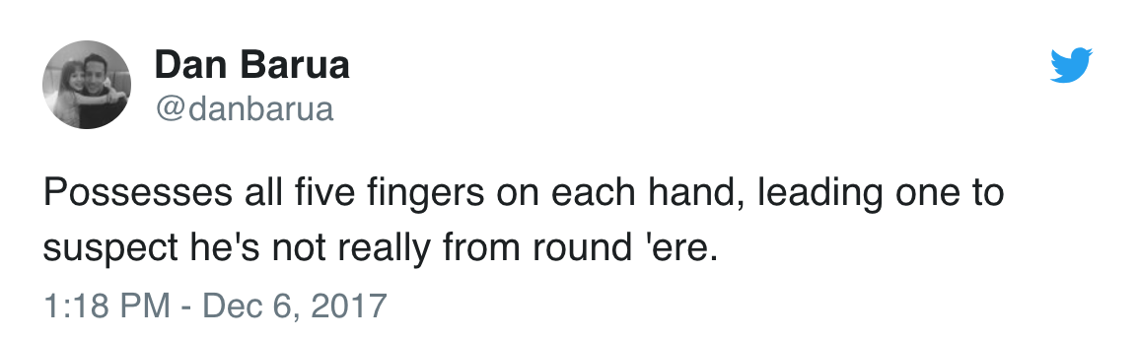
Who am I?
I asked Twitter to write my profile

Slide 5
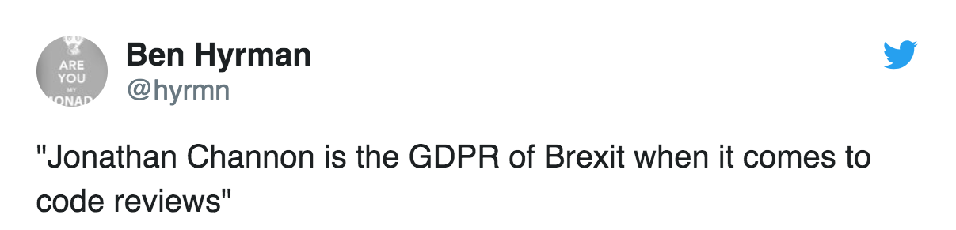
Who am I?
I asked Twitter to write my profile

Slide 6
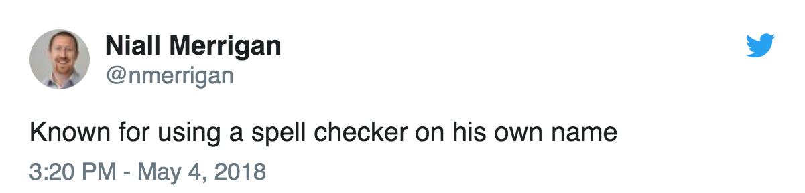
Who am I?
I asked Twitter to write my profile
Notes:
As one of the organisers of NDC Oslo, I thought I could count on some professionalism and respect but apparently not. So if you don’t already no, Niall is a security expert so as an act of revenge I thought I’d implement some features in all my new apps to see how much he sweats

Slide 7
CASE IN-SENSITIVE,
8 BYTE,
A-Z,0-9 PASSWORDS
HTTPS IS EXPENSIVE
NOT ENCODE HTML OUTPUT
PUT CONNECTION STRING
IN GITHUB WITH
BLANK PASSWORD
SQL PARAMETERS
ARE FOR WIMPS

Slide 8

Jonathan Channon
Another Random Developer
Software Developer, @NancyFX MVM, @omnisharp Sublime Plugin Author, Carter author, Former Microsoft ASP.NET MVP, Husband, Father & All Round Nice Guy!
 http://www.vqcomms.com
 https://github.com/jchannon  https://twitter.com/jchannon → jonathan.channon@gmail.com
Notes:
Thank you to VQComms for allowing me to come and speak to you guys. The majority of the team work remotely. We are due to release a major version of our video conferencing management product which is run inside kubernetes on .net core and lots of other buzzwords you can think of!

Slide 9
SOLID Design Principle
As a rock!
S
O
L
I
D
Single Responsibility
Open/Close
Liskov Substitution
Interface Segregation
Dependency Injection
A class should have one, and only one, reason to change.
You should be able to extend a classes behavior, without modifying it.
Derived classes must be substitutable for their base classes.
Make fine grained interfaces that are client specific.
Depend on abstractions, not on concretions.
https://www.microsoft.com/net/learn/architecture
Notes:
SOLID has been used for the past 10 years or so and most developers learn this pattern and apply it at all new projects they start on, tell others to use it. It’s copy and pasted from each project.
It’s so engrained into developers development process that we don’t question it.
In fact Microsoft have written some new documentation for application architecture for microservices & docker, modernizing .net apps and new ASP.Net Core apps. Guess what the underlying theme is in their application design?!
I must make things clear in that I’m not against SOLID as such, the principles make sense and we will use some in our final solution however, I think there has been a strong correlation between SOLID and designing web applications where there are numerous layers and this is what I’m going to focus on. We want to reduce layers and complexity and make things simpler. If there is one thing you take away from this talk it’s exactly that.

Slide 10
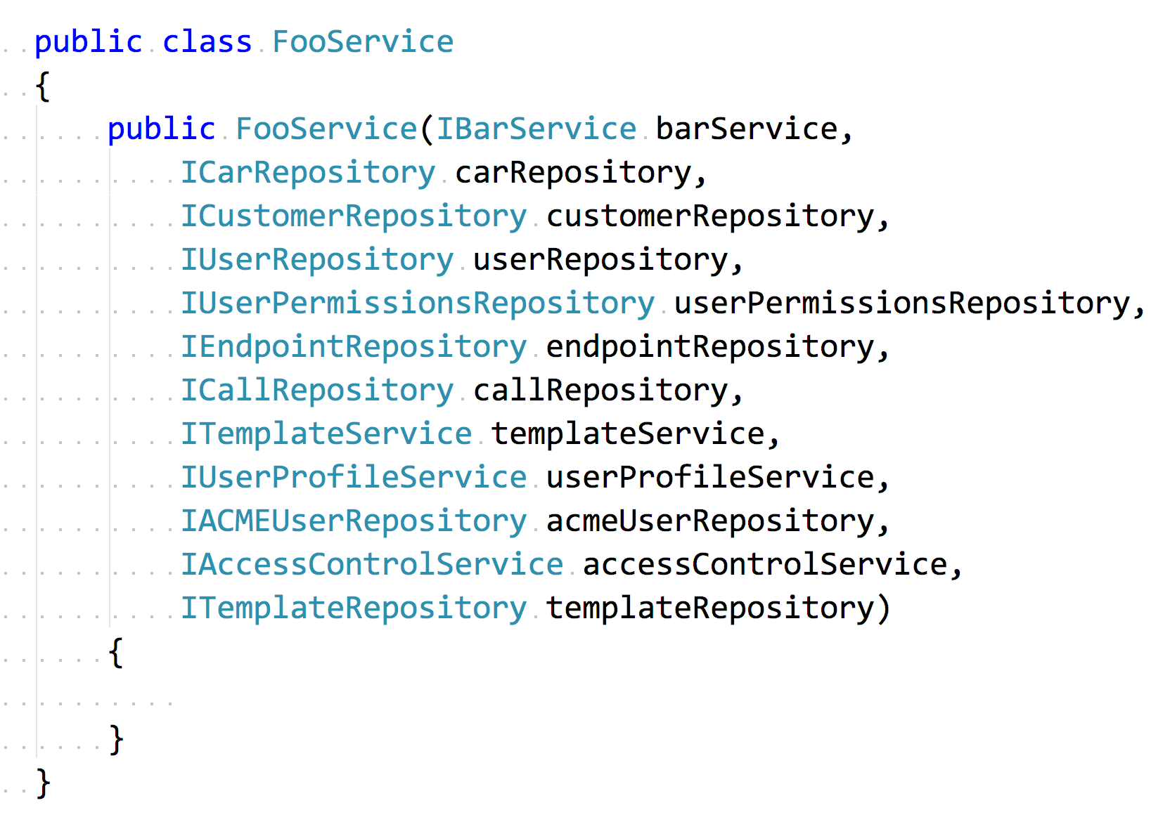
Exhibit A
Your honour!
Notes:
Have any of you seen something like this before?
I ran some dotTrace profiling on our application and one area it picked up was reflection was being slow.
I thought to myself we don’t use reflection anywhere then realised it was complaining about constructors so it must have been my IOC container because under the hood that’s all its doing, finding ctor types and create an instance with those types passed to it.

Slide 11
What to do?
It’s not all what it cracked up to be!
Swap IOC containers
We swapped out to a few containers and tried others
Analyse dependencies
How was each dependency used, was it used in a couple of places for example
More S in SOLID
Create more specific classes rather than a God service class
Consolidate
Put behaviour in one central place rather than abstracting for the sake of it
KISS
Write simple, readable code!
Notes:
So at this point I want to discuss why I decided to do this talk. I had watched a talk by Greg Young called 8 Lines of Code, something that I was aware of but it had taken me far too long to get around to watch it. It was after I had dealt with the previous slide’s dependency hell and it hit home in a few places. What Greg gets at is trying to think about the problem you are solving and how can you do that.

Slide 12
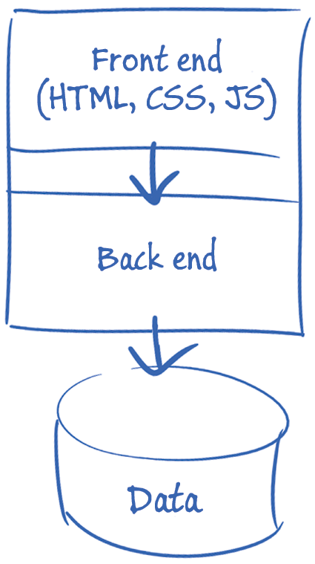
Modern Software Development
Frontend is easy target

Slide 13
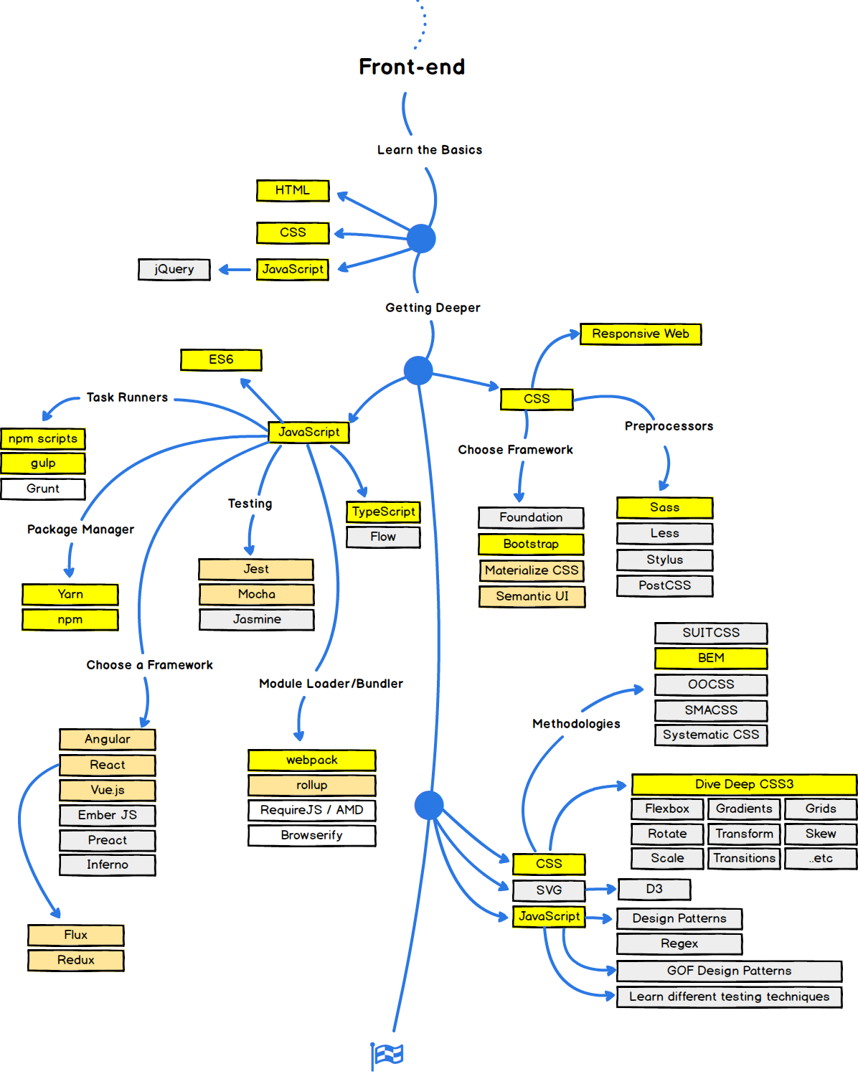
Modern Software Development
Frontend is easy target

Slide 14

Don’t use Magic
No abracadabra please

Slide 15

Don’t use Magic
Sad Ragnar

Slide 16
Points to code by
Architecture rules
Design Patterns
Libraries
01
Don’t use a design pattern because you read something on the internet and you want to shoe horn it into your application. That is CVDD – CV Driven Development!
02
Don’t use libraries for something that can be done simply. Why take another dependency? We all saw how LeftPad turned out?
Frameworks
Tools
03
Don’t use a whole framework for something simple. You don’t need all the bloat
04
If you find you need an extension to your IDE to understand what’s going on, it’s probably not simple
Object relational mappers
Object relation mappers
05
If you need something simple to get a row of data learn SQL and use a lighter library like Dapper.
06
If you need something complex as you’re trying to query aggregate data over many tables in one result set, use SQL. You think an automated tool is going to do that better than you as a developer who understands the structure and domain better?

Slide 17
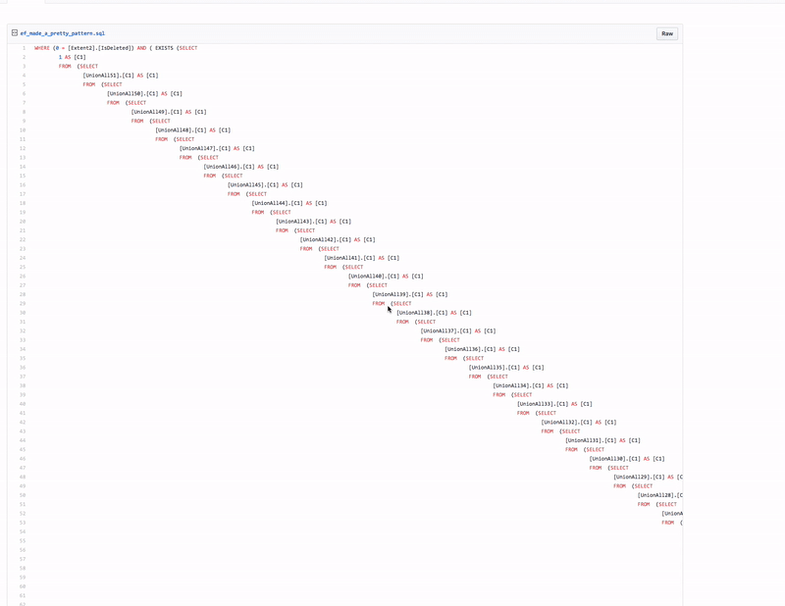
Learn SQL

Slide 18
Comes around full circle
Round round baby
“Always code as if the guy who ends up maintaining your code will be a violent psychopath who knows where you live.”
John Woods c1991
Notes:
If you have to explain intricacies to junior developers on how X works and that you have to stand on one leg and do a dance to the compiler gods for something to work, alarm bells should be ringing!

Slide 19
Project Morphing Time!
Show me the code
SOLID
MediatR
My MediatR
Functional
◉
◉
◉
◉
Demo 1
Demo 2
Demo 3
Demo 4
An example of a typical SOLID/Layered web application
A look at MediatR and how we can consolidate behaviour and use dependencies only when we need them.
How can we lose our dependency on MediatR? That’s right, roll our own!
Magic time! Here we will remove our IOC containers and mock libraries

Slide 20

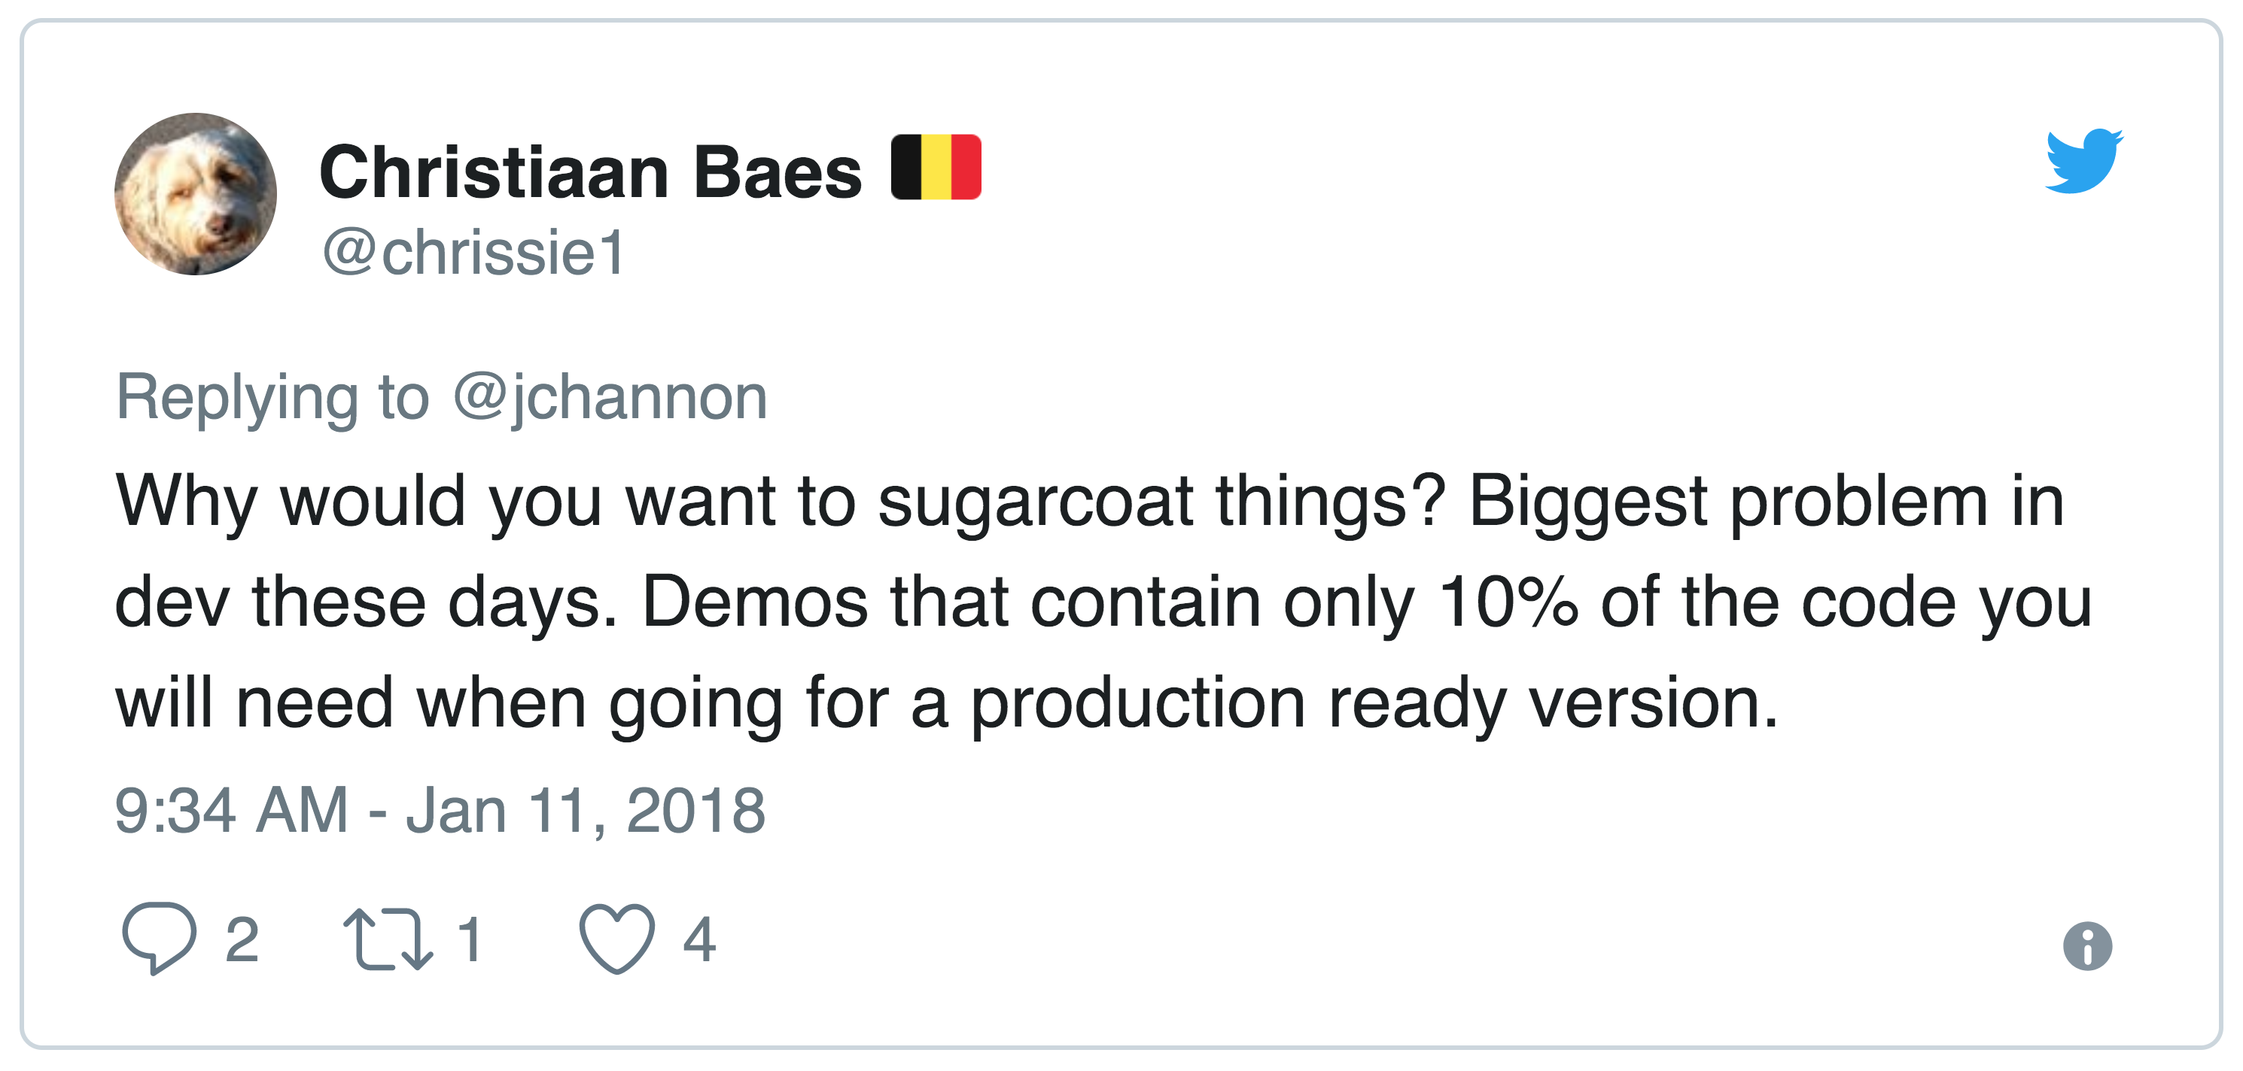

Demo Time!
Let’s Do This!
Notes:
I heard people talking about the approach to no mocks and no ioc and had always thought in my head how would you even do that and one possible solution I had was very messy. That was until I read a blog post from Mike Hadlow, him of EasynetQ fame!

Slide 21
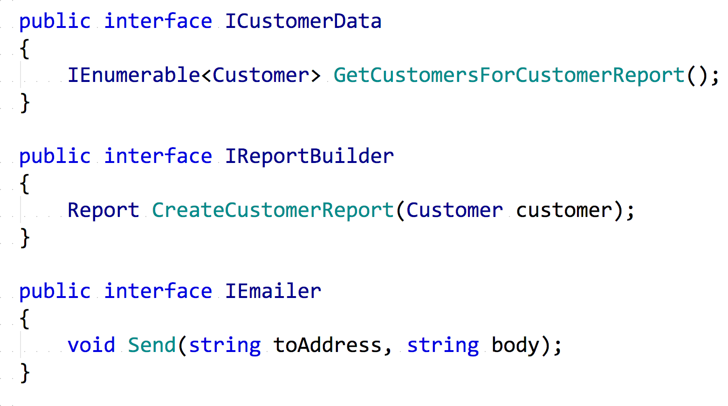

Slide 22
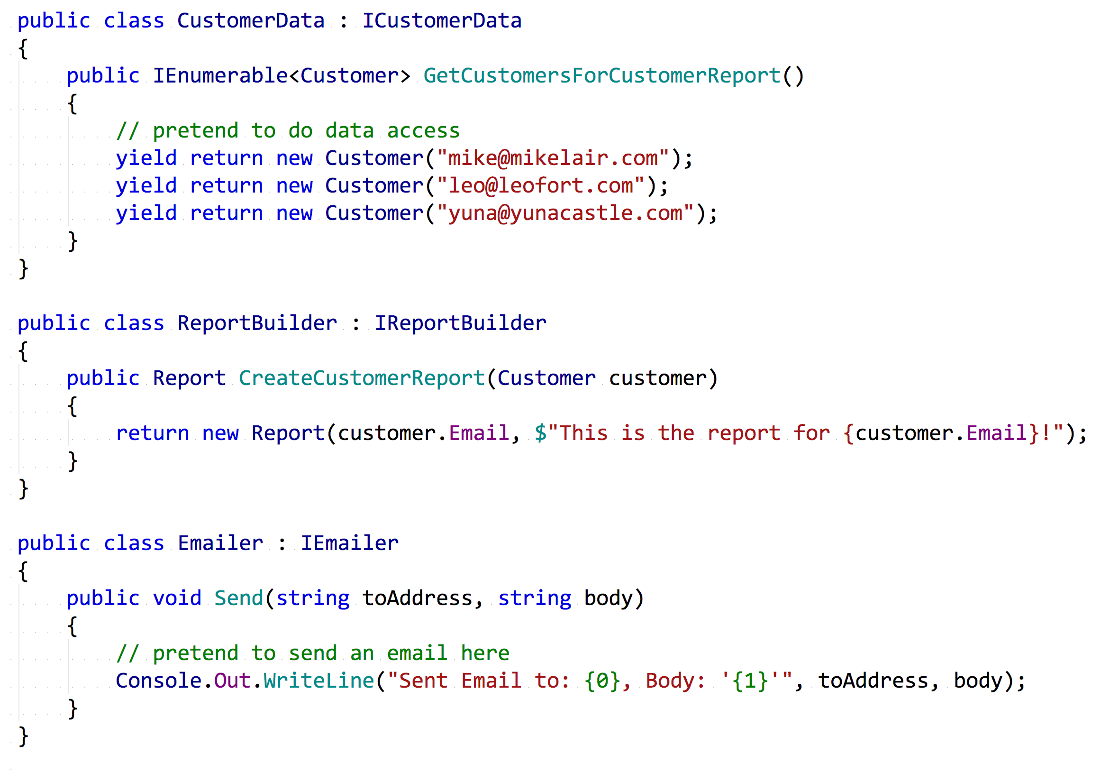

Slide 23
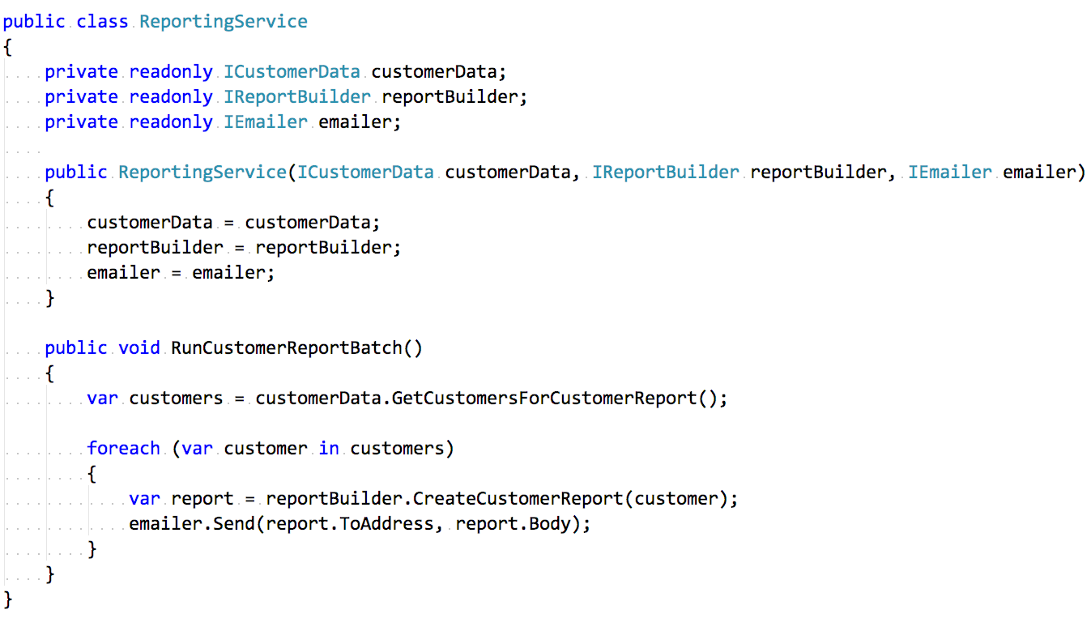

Slide 24
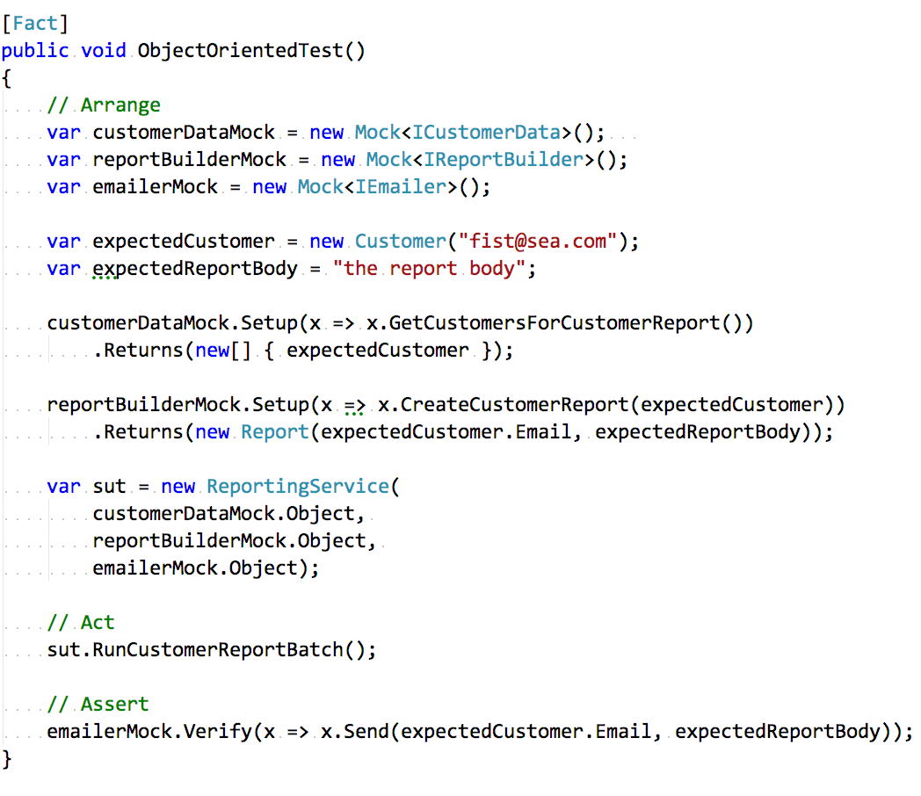

Slide 25
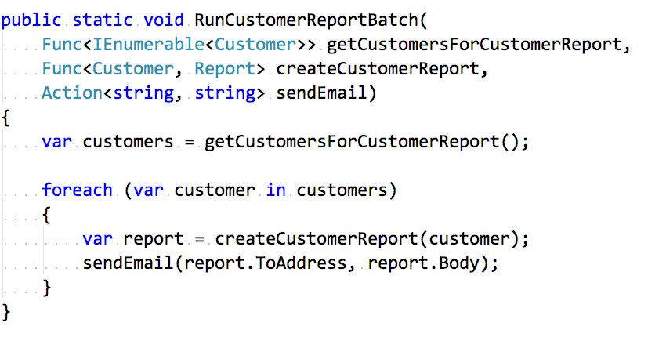

Slide 26
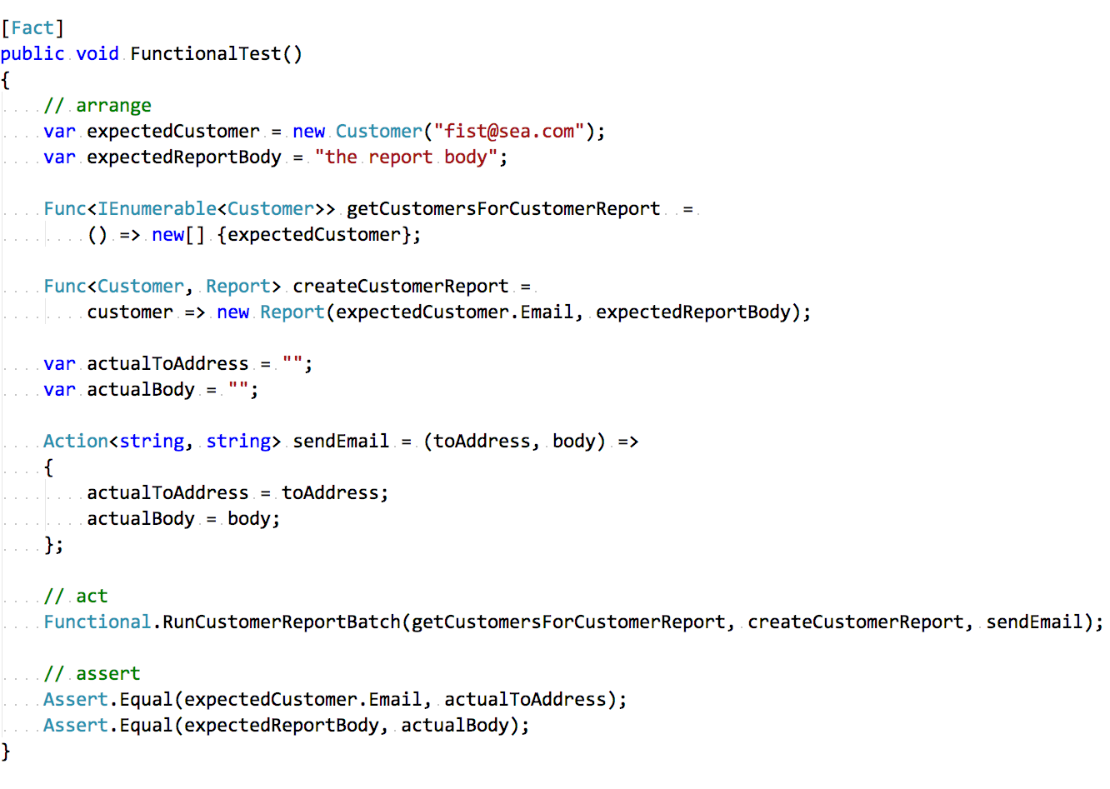

Slide 27

Demo Time…Again!
Let’s Do This!

Notes:
In the spirit of crocodile Dundee “That’s not a framework this is a framework”

Slide 28
Homework Time
Reading is fun
Mike Hadlow
Greg Young
01
Program Entirely in Statics - http://mikehadlow.blogspot.co.uk/2015/08/c-program-entirely-with-static-methods.html
02
The art of destroying software - https://vimeo.com/108441214
Mark Seemann
Brian Geihsler
03
SOLID the next step is functional - http://blog.ploeh.dk/2014/03/10/solid-the-next-step-is-functional/
04
Beyond SOLID: The Dependency Elimination Principle - http://qualityisspeed.blogspot.co.uk/2014/09/beyond-solid-dependency-elimination.html
Greg Young
Dan North
05
8 Lines of Code - https://www.infoq.com/presentations/8-lines-code-refactoring
06
Why Every Element of SOLID is Wrong - https://speakerdeck.com/tastapod/why-every-element-of-solid-is-wrong

Slide 29



Conclusion
You know it makes sense!
Should I still follow layered design?
I’ve just seen something else!
It works!
Have a think to see if it still solves your problems or if there is another approach
It’s productive but also enjoyable to use!
Less dependencies & more performance! Next problem please!

Slide 30


Thanks for your time!
Go forth and hack!
Source Code : github.com/jchannon/T1000
Notes:
Any questions?
Code is on Github? Do we still push code to Github or is it somewhere else the cool kids have gone to?
Oh and if anyone sees Troy Hunt, tell him I have his hat and hope his talk went well!

